Slide 1
Business Process Engineering
Lean Processes
Lecture: 16

Slide 2
Lean Process
A systematic approach to improve efficiencies of the business process while reducing wasteful activities that tarnish business results (value).
A systematic approach to identifying and eliminating waste through continuous improvement by flowing the product at the pull of the customer in pursuit of perfection
James Womack
Notes:
The theory is simple – by eliminating products, services, or business practices that don’t enhance or facilitate your customer’s journey, you streamline the purchase and fulfillment phase to create a better customer experience.

Slide 3
Lean is about
Increase efficiency, effectiveness, and quality of processes
Lower operating costs
Improve customer satisfaction
Improve customer morale
Free up resources to be used elsewhere
Notes:
Improve 30% now rather than 100% later

Slide 4
Taichi Ohno tasked to improve the production to meet the demand
Studied American car manufacturers
Devised a new process with other management experts

Slide 5

Notes:
Source: https://www.youtube.com/watch?v=F5vtCRFRAK0

Slide 6
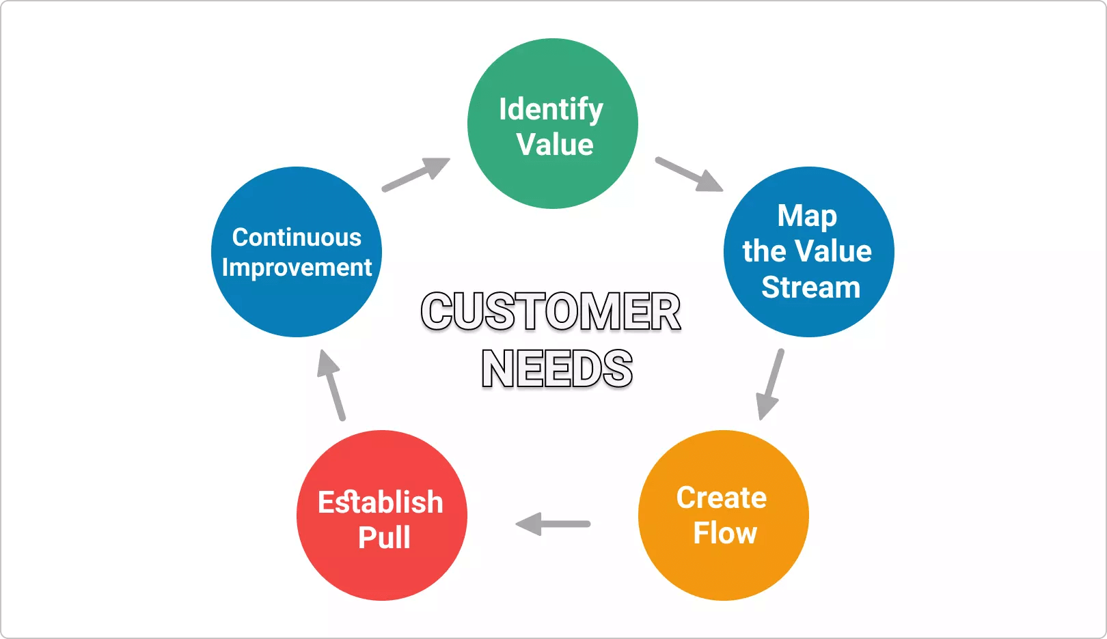
Lean Key Principles
Identify Value
Map Value
Create Flow
Establish Pull
Continuous Improvement

Slide 7
1 Identify Value
Need to understand what customer needs
Need to understand and define the end product

Slide 8
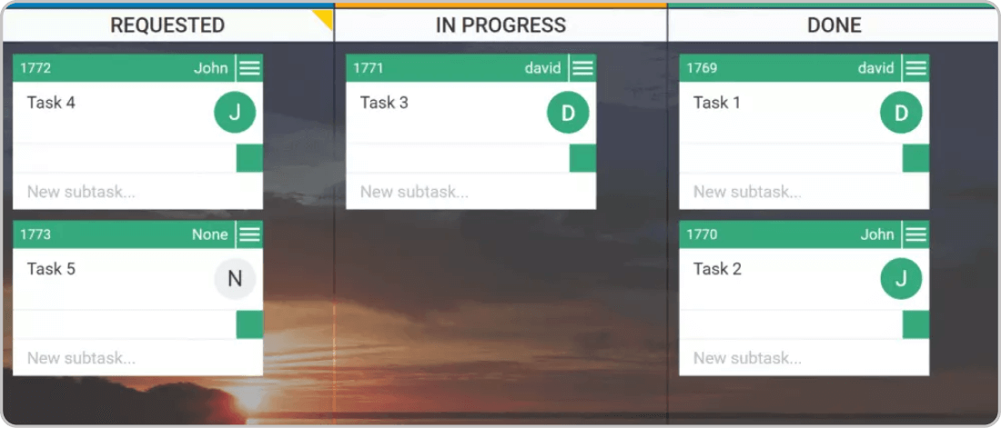
1 – Mapping Value Chain
Identify value stream
Map to identify wastes and source of wastes
Identify value stream
Map to identify wastes and source of wastes

Slide 9
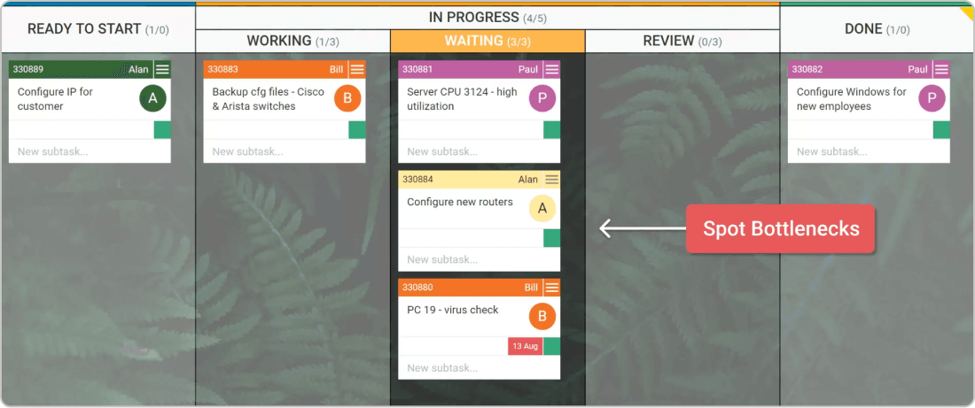
3 – Create a Flow
Remove delays to create flow
Steps in your value chain should go from one to the next without delays
Remove delays to create flow
Steps in your value chain should go from one to the next without delays

Slide 10
4 - Establish Pull
Create a system to develop what next down stream customer needs
Only start work when there is a demand

Slide 11
5 – Continuous Improvement
Constantly improve every process
Can be achieved via PDCA
It is more of a shared value than an instructed principle

Slide 12
Advantages of Lean Processes
Shorter Time
Decrease inventory
Increased productivity
Lower costs

